Slide 1
Reversi / Othello
By David Chen and Nicola D’Addamio

Slide 2
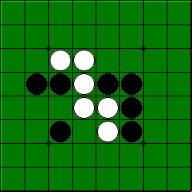
What is Reversi/Othello
It is a simple game with a single goal; the objective is to have the majority of your color discs on the board at the end of the game.
Strategy board game for two players.
Played on a 8x8 uncheckered board.
Reversi was invented in 1883 and Othello was patented in 1971.
Note: we are going to focus on the Othello variant for the course of this project.

Slide 3
Game Rules
Black always goes first.
If and only if you cannot make a move during your turn, you simply pass and the opponent moves again.
A disc may outflank any number of discs in one or more rows in any number of directions at the same time (horizontally, vertically or diagonally -- as long as in a continuous straight line).
You cannot skip over your own color.
Disc(s) can only be outflanked as a direct result of a move and not as an aftereffect .
All discs outflanked in any move must be flipped, even if it to the player’s advantage not to flip them all.
If a player makes a mistake in flipping discs, it can be corrected as long as the opponent has not made a move after that. If the opponent has made a move, it is too late to change them back.
A disc cannot be moved after it is placed on the board.
When neither of the players can make another move, the game is over.
Note: It is possible for a game to end before all 64 squares are filled.

Slide 4
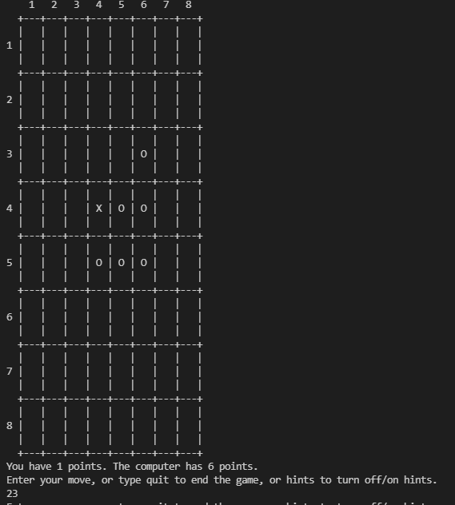
Main Source Code - How does it work?
-Source Code: http://mcts.ai/code/python.html
Our main functions:
drawBoard
resetBoarget
isValid Move
getScoreOfBoard
enterPlayerTile
showPoints
makeMove
getComputerMove-ai

Slide 5
Current ai (getComputerMove)
AI checks if the possible next move includes a “corner move”, if yes, play the corner move, if not, play the best move.
Looks for the move that does the most flips from a random given list of moves.
And repeats until a move cannot be made anymore or a player wins.
Note: very simple and randomized AI that plays with a brute force method.

Slide 6
How can we improve the AI?
High Priority list of moves.
Remove the random aspect of the old source code to select the next move.
Try to take over the corners of the board and then the edges (which is the next important strategy).
Low priority list places for the AI to avoid or “pay less attention”.
Avoid mid rows and columns outside the 4*4 center square. For example row 2,7 and column 2,7 (these locations are very easy to overtake and can cause access to outside edges and corners).
Leave the corners out for last to select as final moves.
At the start of game, try to only play in the center 4x4 until required or opposite player plays outside of such square.

Slide 7
References
Othello.pdf (fgbradleys.com)
http://mcts.ai/code/python.html
Reversi - Wikipedia
How to play Othello | Official Rules | UltraBoardGames

